Slide 1




Introduction
April 21, 2021
Adding AI to Edge Devices
Radhika Sethi
ROLL NO - 3456
C22018221381
COMPUTER ENGINEERING
CUMMINS COLLEGE OF ENGINEERING
Eaton Pratibha Award, April 2021
R&D Head at AICVS
Co-Lead at Google's DSC
Contributing at OpenMined, HinglishNLP
Volunteer at PyData Pune, PyCon India
Wabtec Exceed 2019 Pan India Finalist
Member of MLIndia Community, 2018
Presented by
Radhika Sethi

Slide 2

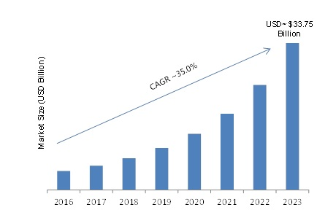

Statistics on Edge AI
Growth of AI at the Edge
According to McKinsey, AI could deliver an additional economic activity of $13T by 2030 or 16% of today’s GDP.
The business value of edge-based ML becomes obvious in the power management and electrical industries, like Eaton, where company employees work in sites far from populated areas.
Advantages of Edge-based AI
less lag time
lower bandwidth consumption
reduces data transmission costs
Precision monitoring and control
Predictive maintanence
Edge computing is set to become a $34 billion industry with the estimated growth of 35% by 2023 in comparison to the centralized data services
01

Slide 3



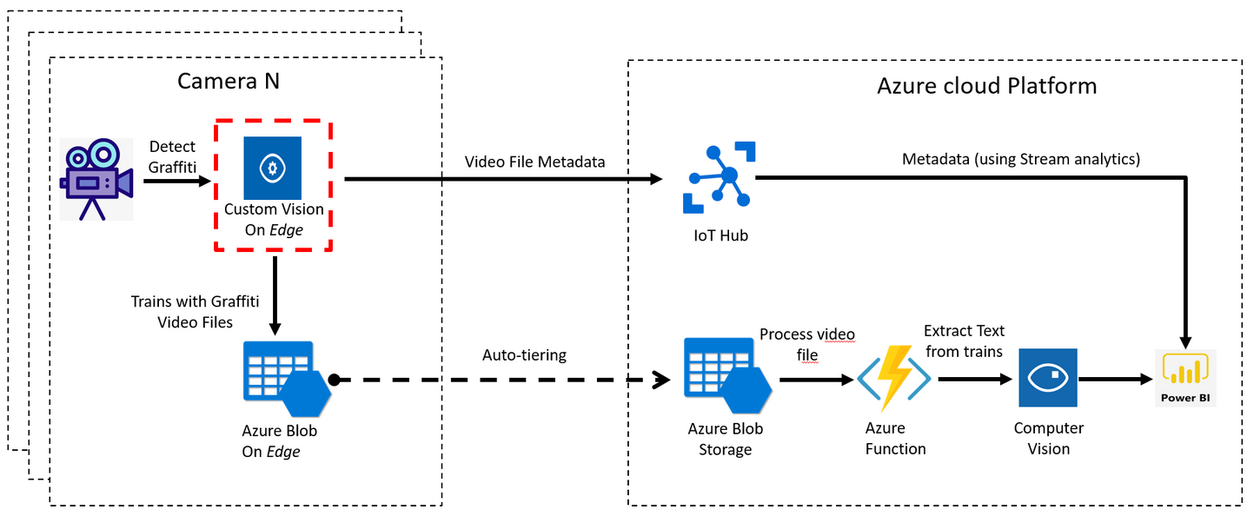
How can we transfer ML Algorithms from the cloud to the edge?
Deploying models to the edge
Example - Graffiti Detection Model trained using Azure Custom Vision, exported to an Azure IoT Hub
Transferring ML models from Cloud to Edge
Training models on the edge
We'll come to this soon!
02

Slide 4
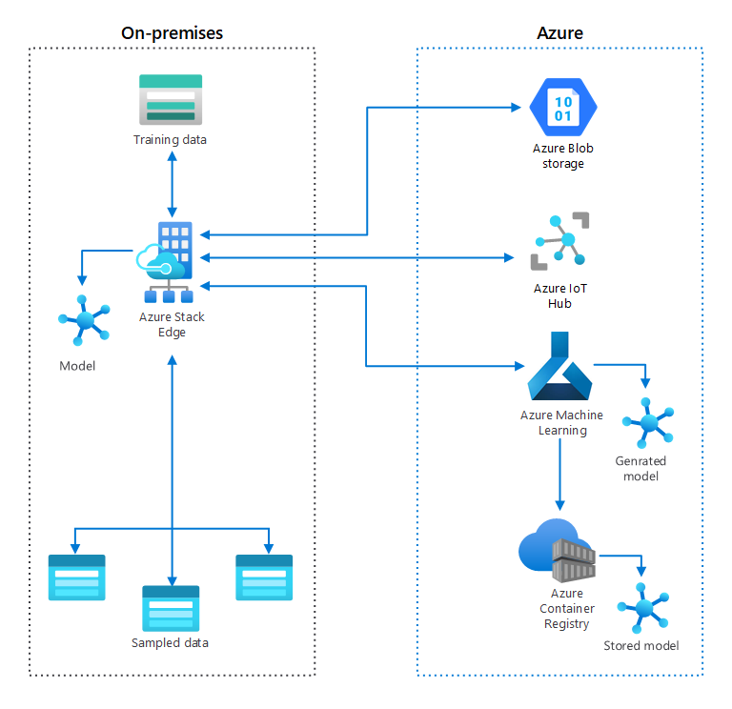
Do we have any standard frameworks to transfer algorithms?
Frameworks
Azure Stack Edge
2. Edge Device Model quickstart by GCloud
Example - Deploying on Tensorflow Lite. It is optimized for mobile phones and ARM. (Demo!)
3. AWS for the Edge
Currently in use by Phillips, Volkswagen, Cradlewise
AWS IoT Greengrass - opensource edge runtime and cloud service (IoT)
3
03

Slide 5

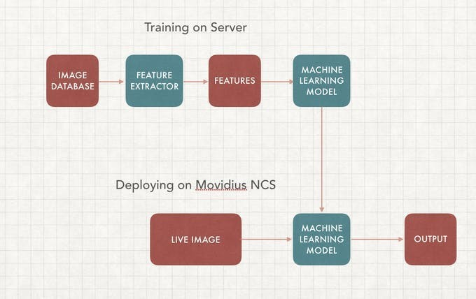
Are there any limitations?
Limitations of Transferring ML algorithms to the edge
Latency issues pertain
Transmission of data from device to cloud still pertains.
Much data is still transferred back to the cloud storage
A considerable amount of cost is involved - to train the model on the cloud, store all the data collected at the edge, onto the cloud
Deep Learning Computer Vision Model Deployment on Intel Movidus NCS -2
04

Slide 6
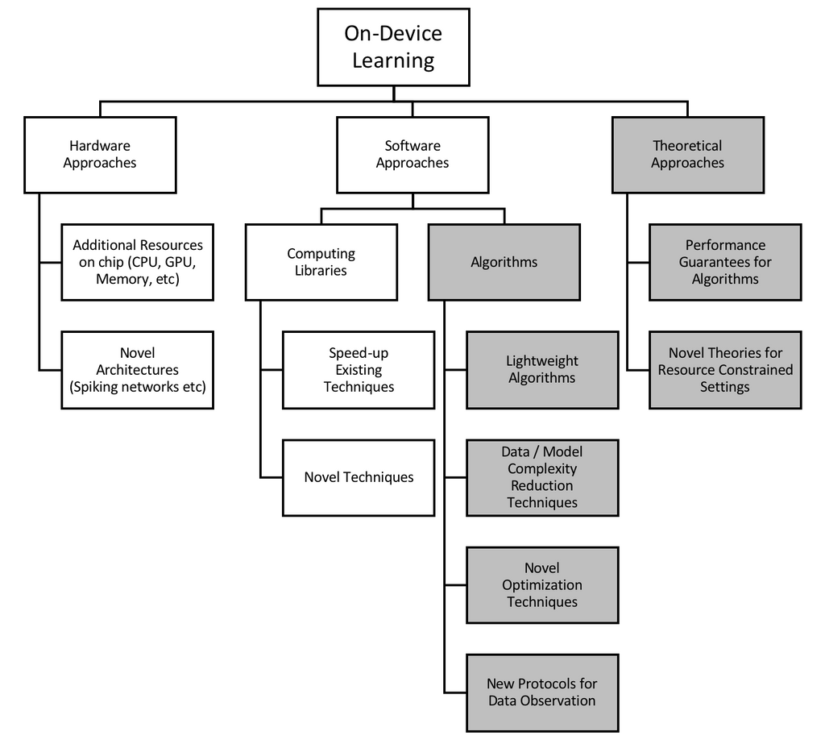
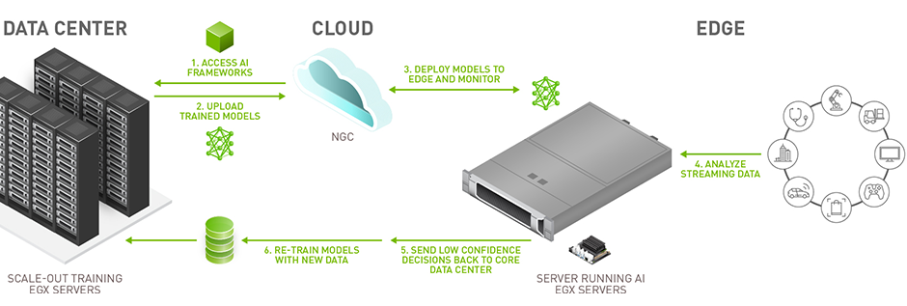
How do we train the model at the edge?
Training ML models on the edge
Optimal hardware - application-specific integrated circuits (ASICs), field-programmable gate arrays (FPGAs), RISC-based processors, and embedded graphics processing units (GPUs).
Examples of fully integrated hardware systems - Coral System-on-Module (SoM) by Google, The Intel Neural Compute Stick 2 (NCS2), ARM Ethos N-77
05

Slide 7
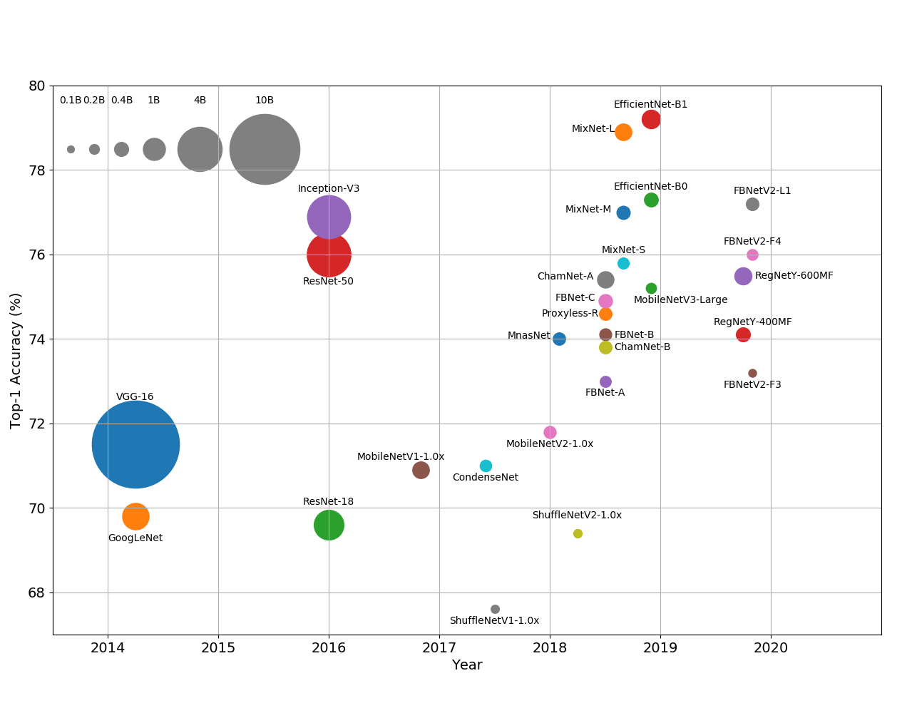
How do we train the model at the edge?
Training ML models on the edge
Reducing Model Complexity: Dominant approach for deploying resource-efficient models. there has been a slow but steady progression towards smaller, faster, leaner architectures in Deep Neural Networks
This progression has been helped by Neural Architecture Search (NAS) techniques that show a preference for smaller, more efficient networks.
06
Ball chart of the chronological evolution of model complexity. Top-1 accuracy is measured on the ImageNet dataset.

Slide 8
Are there any limitations?
Limitations of training ML algorithms on the edge
The need to decouple algorithms from the hardware and design effective loss functions.
Improved methods for model profiling are needed to more accurately calculate an algorithm’s resource consumption.
Our everyday devices are often multi-tasking. Taking this changing resource landscape into account is an important challenge for effective model training on the edge.
There is a need for resource-efficient model building
07

Slide 9
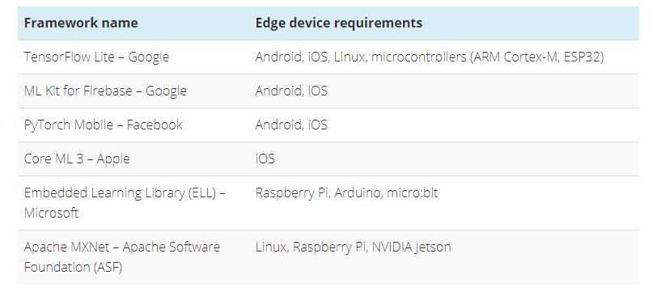
Popular ML Frameworks that run on edge devices
ML Frameworks for IoT Edge Devices
08

Slide 10
Summary
Summary
If AI is the Spaceship then Data is the Rocket Fuel
Designing power-efficient ML algorithms, developing better-specialized hardware, and inventing new distributed-learning algorithms where all IoT devices communicate and share data.
Devices can be truly powerful once we sever the lifeline that extends between the device and the cloud. That requires the ability to train machine learning models on devices itself.
Future 5G networks, which provide ultra-reliable, low-latency communication services, will help immensely in the domain
Development of algorithms that can train models under resource constraints will be a game-changer.
09

Slide 11
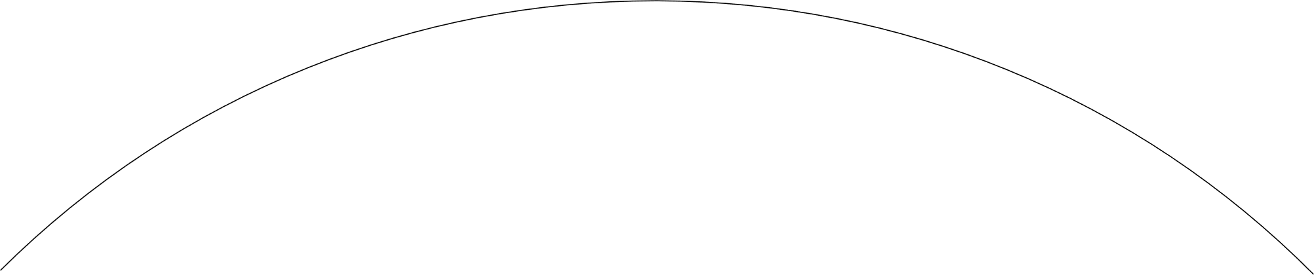



My take on Edge AI - Deploying ML to an edge device
In service-based industries such as the finance and e-commerce sector, edge computing devices also have roles to play. In this case, a smart phone, laptop, or tablet becomes the edge computing device.
Accelerating the inference by delegating local GPU to the application
Set up an android application to run the trained model on an android app
Deploy the model on a phone! (Edge device)
Trained a flower classifier, object detection model on Google Colab as a tflite model
Test the model, while realizing the resource restrictions
Taking applications to the edge
latency : 90ms
latency : 110ms
10
Thank You!

